Slide 1

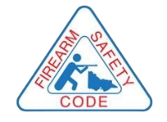
Victorian Longarms
Firearm Safety Course
Revised 2023
Version 1.2 2023

Slide 2
Introduction: Firearms safety course
This Firearms Safety Course is specific to longarm firearms. It is approved by the Chief Commissioner of Police per Section 179 of the Firearms Act 1996.
All applicants for a Victorian Longarm Firearms Licence must complete the course.
To complete the course, you must pass two multiple choice knowledge tests.
To find out about other licence types and eligibility requirements visit police.vic.gov.au/firearms.

Slide 3

Course Topics
Introduction
Firearm information
Firearm Safety Rules
Handling firearms in the field
Firearms Law – Firearms Act 1996
Carrying and managing firearms
Firearm storage
Before you go shooting
Discussion
Knowledge test 1 – Firearms Safety Rules
Knowledge test 2 – Firearms Law

Slide 4

Unsafe handling, storage and behaviour make firearms dangerous

Slide 5

Hunting related deaths and accidents
Between late 2017 and early 2021, four hunters have been killed through accidental shooting in Victoria.
Source: Victoria Police
Causes of firearms deaths and accidents
Mistaking another hunter for prey
Open a gate with a loaded firearm
Retrieving a shot duck from water
Reloading in a vehicle
Climbing through a fence
Shotgun spread
Climbing on a vehicle
Firearm entangled in bush
Source: Victorian Institute of Forensic Medicine 2010. Australian external cause deaths while engaged in hunting activities.

Slide 6



Your responsibilities
If you want to own and use firearms you must be aware of your responsibilities to:
  Keep yourself safe
  Keep your family safe
  Keep the community safe
You must know and apply the safety rules when you are using, transporting and storing firearms.

Slide 7
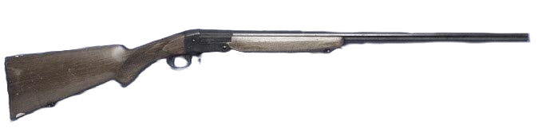
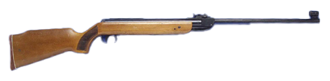
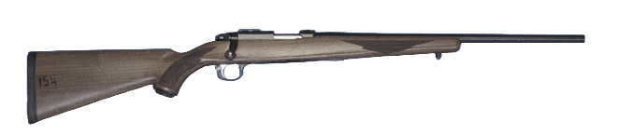
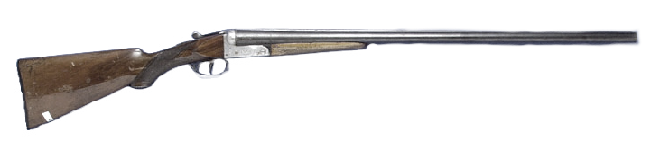
Longarm firearm types and actions
Category A
an airgun
a rimfire rifle (other than a semi-automatic rimfire rifle)
a shotgun (other than a lever action pump action or semi-automatic shotgun)
any combination of a shotgun and rimfire rifle

Slide 8
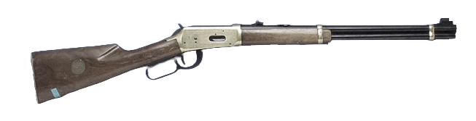
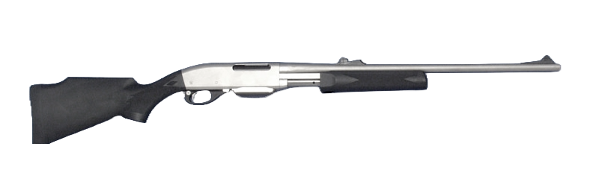
Longarm firearm types
and actions
Category B
a muzzle loading firearm
a centre fire rifle (other than an automatic or a semi-automatic centre fire rifle)
any combination of a shotgun and centre fire rifle
a black powder, ball firing cannon
a lever action shotgun with a magazine capacity of no more than 5 rounds

Slide 9
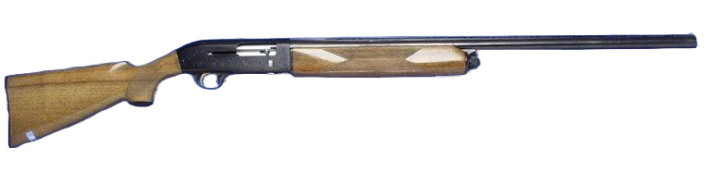
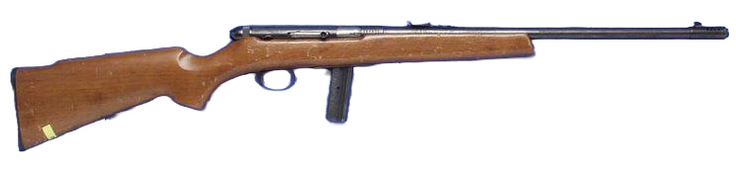
Longarm firearm types
and actions
Category C
a semi-automatic rimfire rifle with a magazine capacity of no more than 10 rounds
a semi-automatic shotgun with a magazine capacity of no more than 5 rounds
a pump action shotgun with a magazine capacity of no more than 5 rounds
a tranquilliser gun

Slide 10
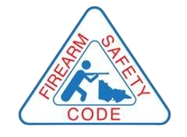
Firearm safety rules

Slide 11
10 Firearm Safety Rules
1. Treat every firearm as loaded.
2. Always point firearms in a safe direction.
3. Load a firearm only when ready to fire.
4. Identify your target beyond all doubt.
5. Check your firing zone.
6. Store firearms and ammunition safely.
7. Avoid alcohol or drugs when handling firearms.
8. Never have loaded firearms in the car, camp or home.
9. Never fire at hard surfaces or water.
10. Don’t climb fences or obstacles with loaded firearms.
Observe the code.
Insist others do the same.
Learn, practice, teach and promote the firearm safety rules.

Slide 12
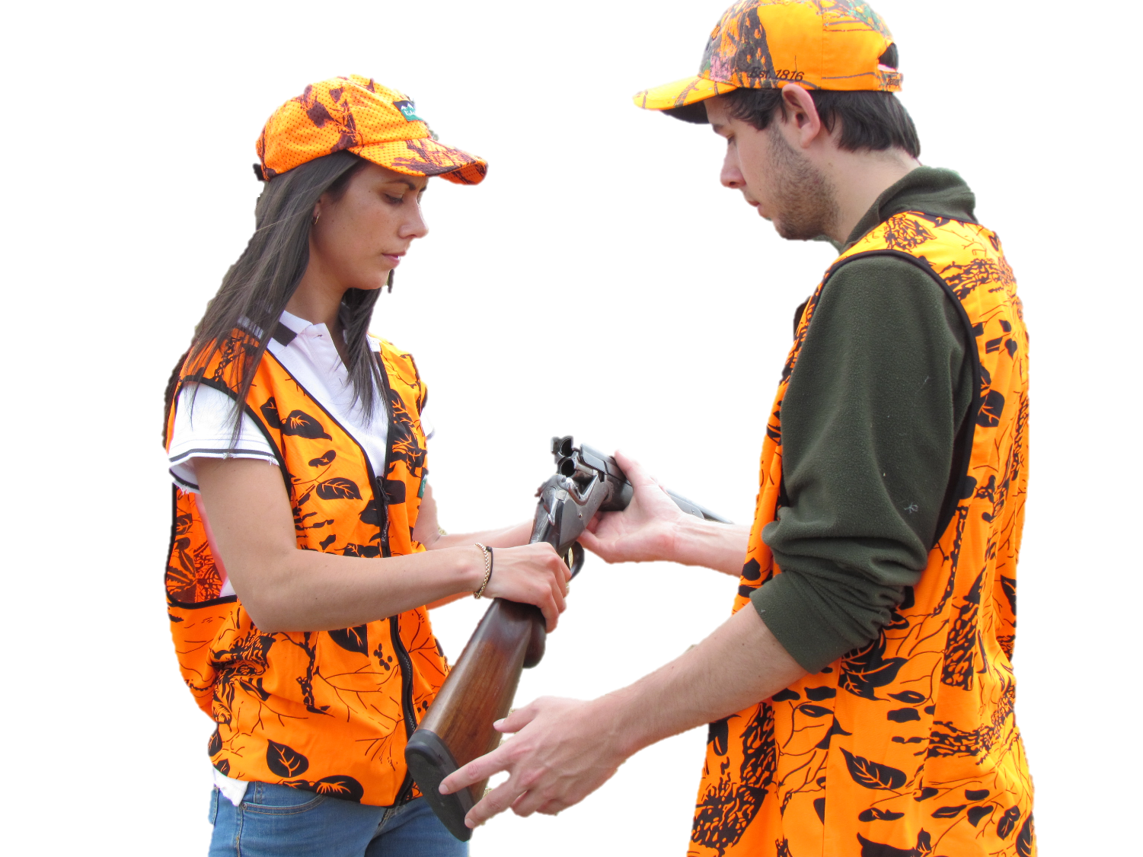
Safety rule 1: Treat every firearm as loaded

Slide 13
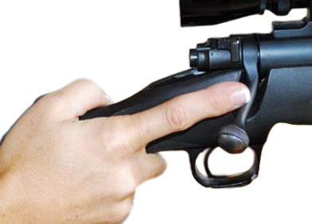
Treat every firearm as loaded
Don’t take anyone’s word that the firearm is not loaded
Finger outside the trigger guard
Point the muzzle in a safe direction and back drop
Open bolt or action
Inspect the chamber/magazine
Don’t know how to open it? Seek help. Don’t attempt to open

Slide 14
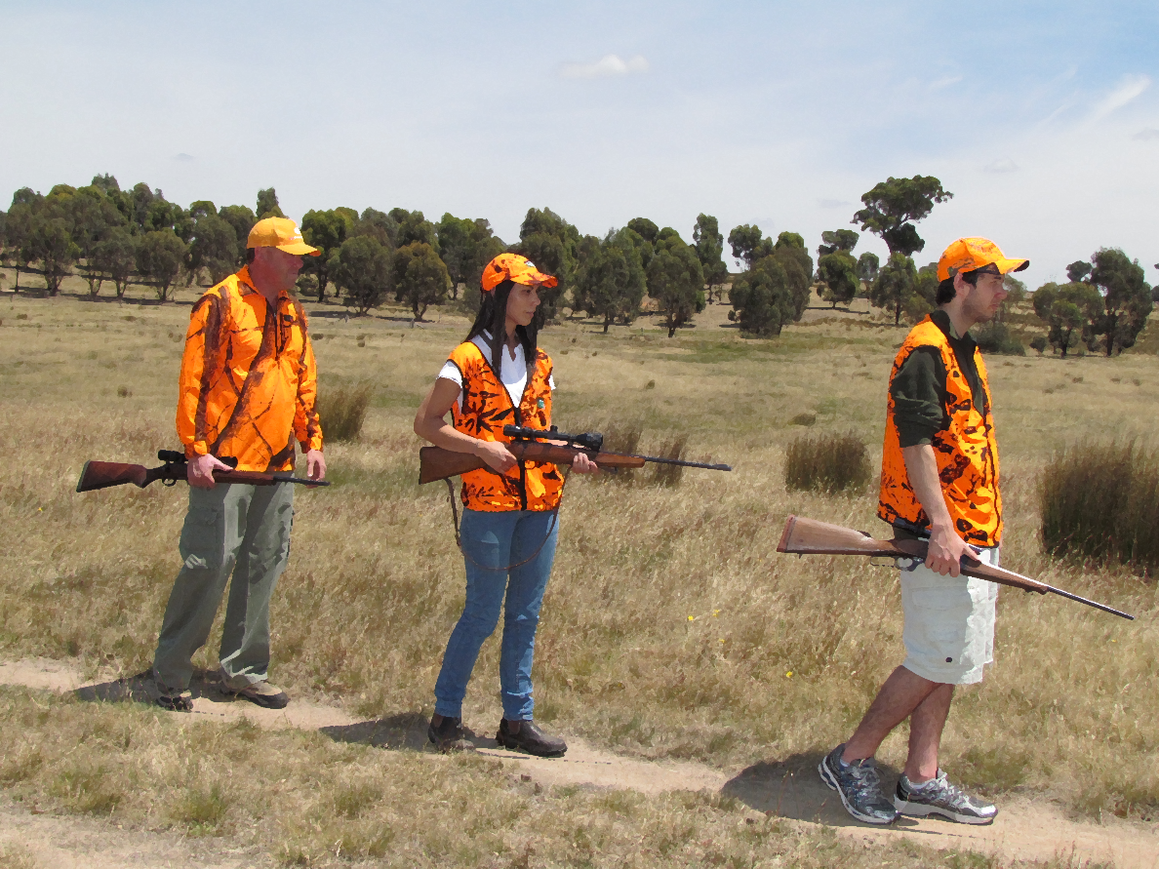
Safety rule 2: Always point firearms in a safe direction

Slide 15
Always point firearms in a safe direction
A safe direction will depend on where you are.
Always treat your firearm and the firearm of others as ‘loaded’.
Never point a firearm at anyone else or yourself.
Don’t allow careless habits to form and compromise safety.
Concentrate on the safe handling of your firearm.
Don’t lean a firearm against a vehicle or place where it could slide or fall.
Safe direction?
A direction that, should the firearm discharge, there would be no loss of life, no injury to another person, yourself and/or minimal damage to property.

Slide 16
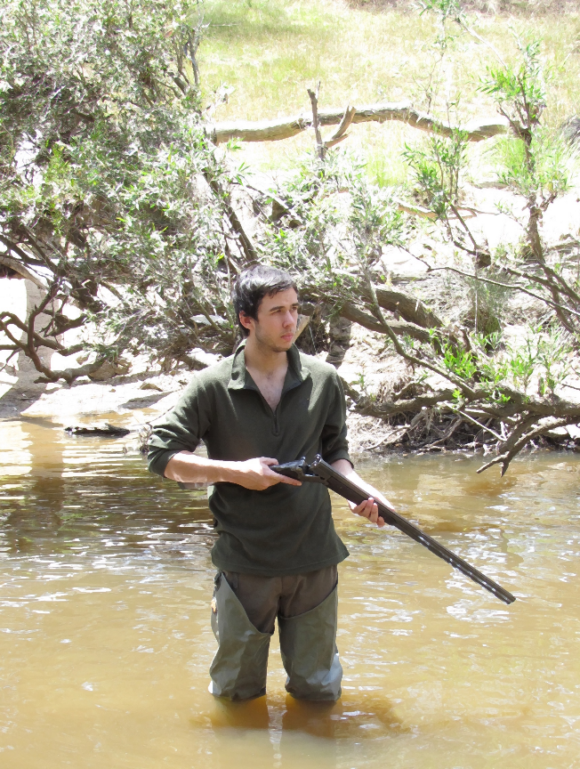
Safety rule 3:
Load a firearm only when ready to fire

Slide 17
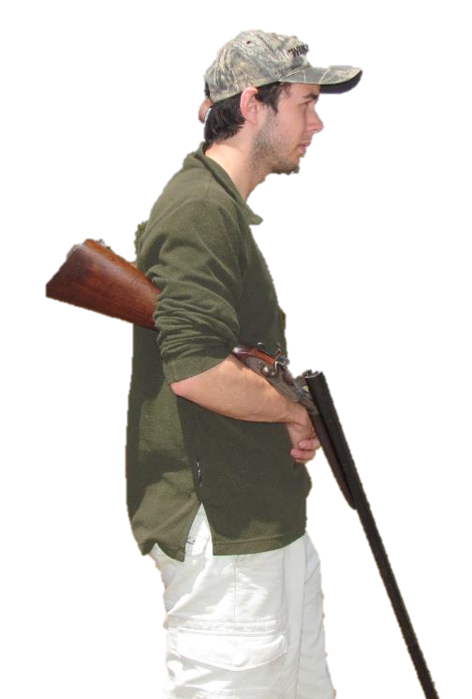
Load a firearm only when you are ready to fire
Only load a firearm in an area where it can be safely and legally discharged.
Carry with bolt half open or in semi readiness
Only load your ammunition into the magazine when you have reached your shooting area.
DO NOT load the chamber until you are ready to shoot.
Unload the chamber when not firing a shot.
Unload completely with no rounds in the chamber or magazine before leaving a shooting area or entering a hut or camp

Slide 18
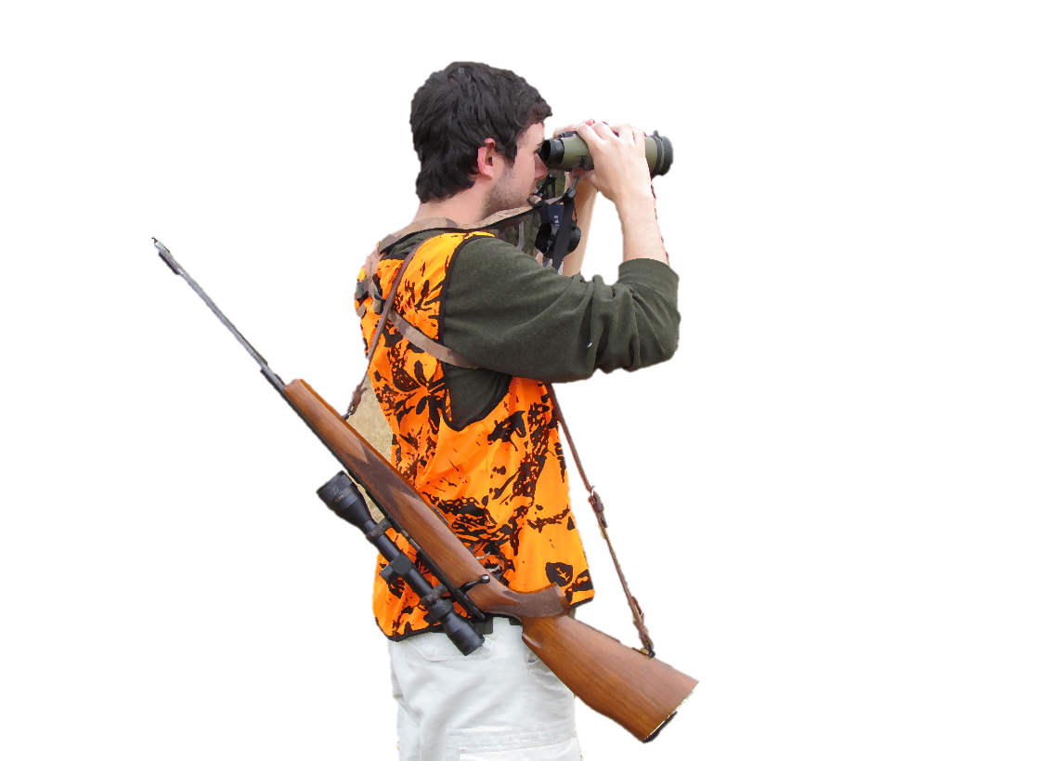
Safety rule 4:
Identify your target beyond all doubt

Slide 19
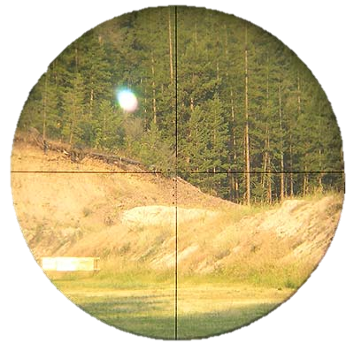
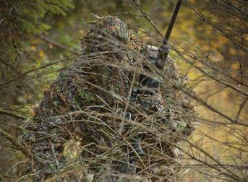
Identify your target beyond all doubt
People can look and sound like game animals
NEVER FIRE until you are absolutely certain.
Your target must be positively identified before firing.
If in doubt DO NOT SHOOT
Never shoot at:
Movement only
Colour only
Sound only
Shape only
Heat signature only

Slide 20
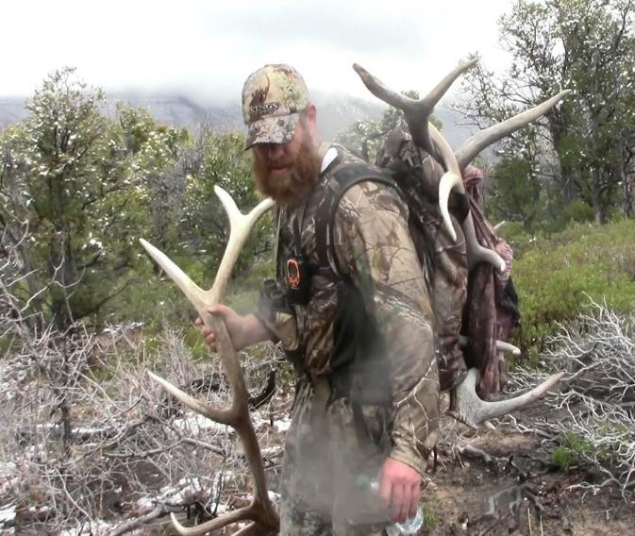
Identify your target beyond all doubt
Consider wearing an orange blaze vest
(your prey won’t know)
Before you shoot ask yourself, is this a person?
This will focus your mind towards expecting to see a person, rather than assuming it is an animal.
Keep your finger away from the trigger until you are ABSOLUTELY CERTAIN it is safe to fire.
It is always the responsibility of the shooter to identify their target beyond all doubt. This is regardless of whatever strategies other hunters may or may not use to be seen.

Slide 21
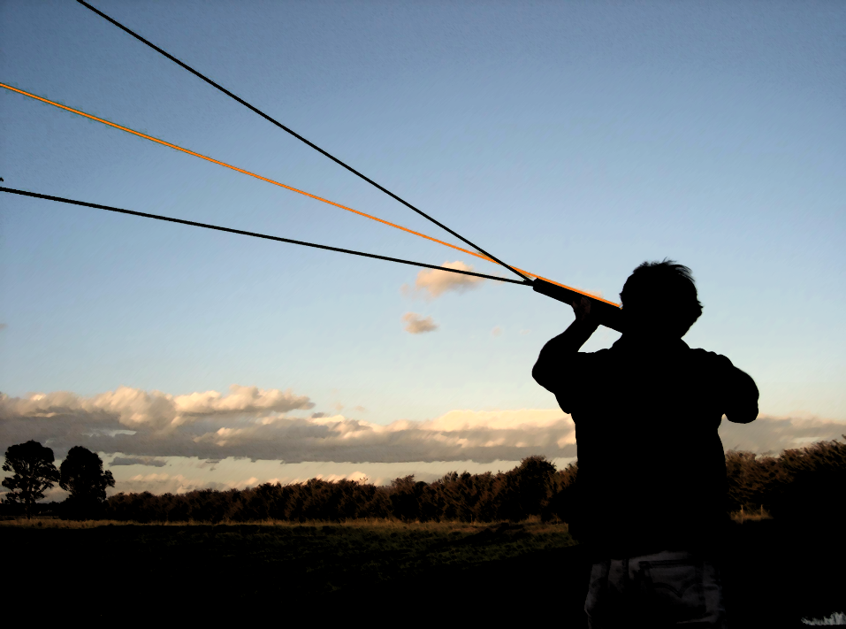
Safety rule 5:
Check your firing zone

Slide 22
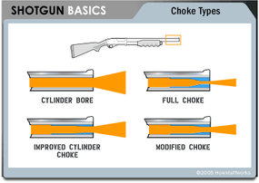
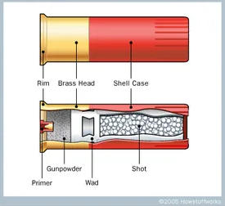
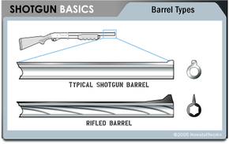
Check your firing zone
Shotguns
The firing zone of shotguns requires special attention because the shot pattern becomes wider at longer distances.
Rifles
Create the additional risk of long distance and over penetration

Slide 23
Check your firing zone
303/30-06 centrefire – distance 4000 meters
22 rimfire – distance 1500 meters
12 gauge shotgun – distance 300 meters
Air rifle– distance 150 meters

Slide 24
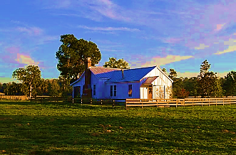
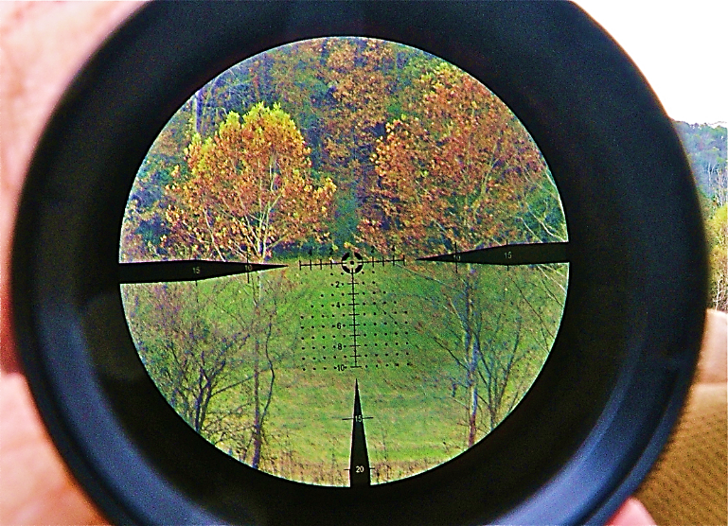
Check your firing zone
What is to the left or right of your target?
What is behind your target?
What is between you and your target?
When using spotlights or telescopic sights you limit your field of view. You must take special care when using these tools.
What is to the left or right of your target?
What is behind your target?
What is between you and your target?

Slide 25
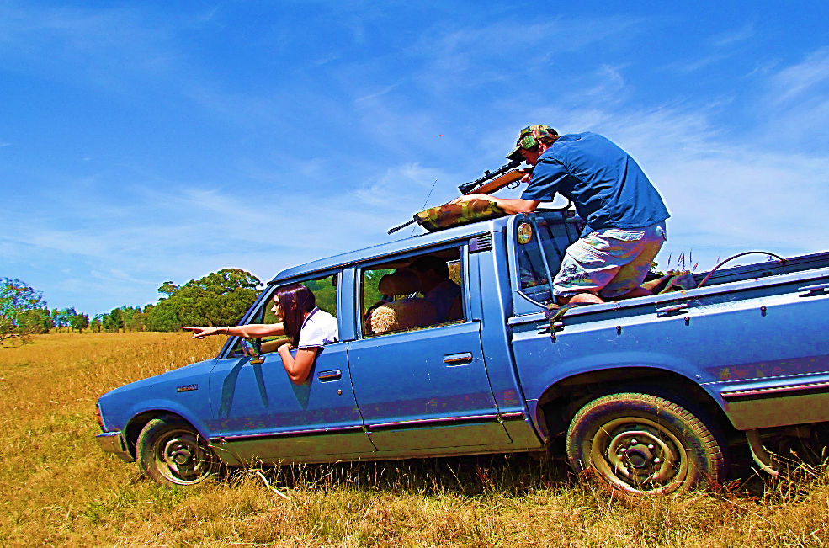
Check your firing zone
What is to the left or right of your target?
What is behind your target?
What is between you and your target?
Make sure there is nothing between you and your target.
Be aware that passengers may make sudden movements that endanger themselves.
Rough terrain may cause unexpected movement of your muzzle direction.

Slide 26
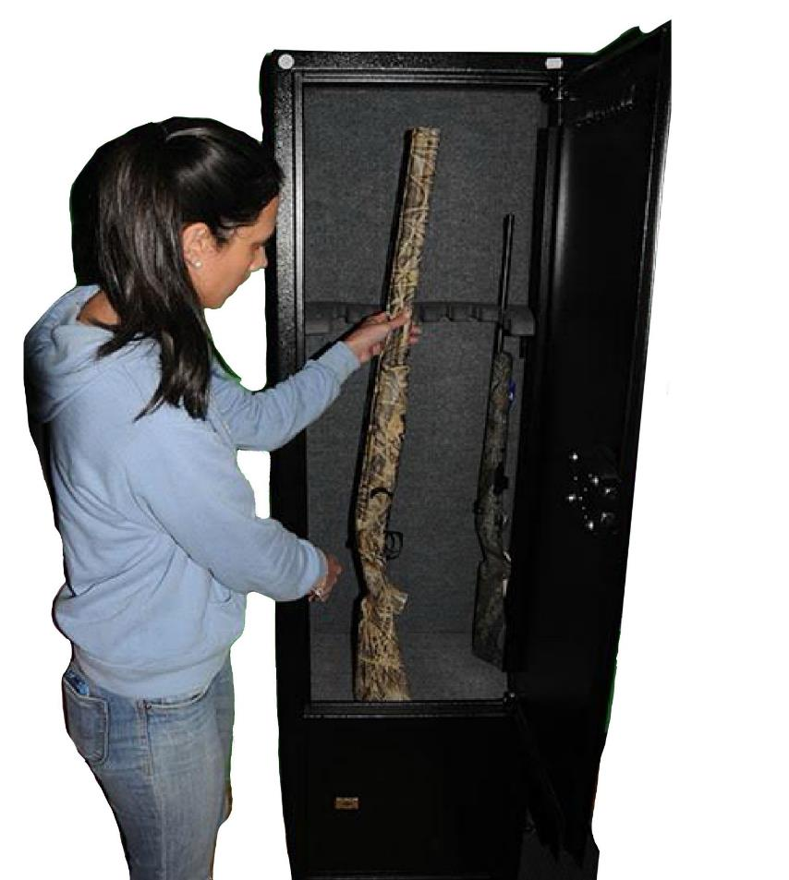
Safety rule 6:
Store firearms and ammunition separately

Slide 27
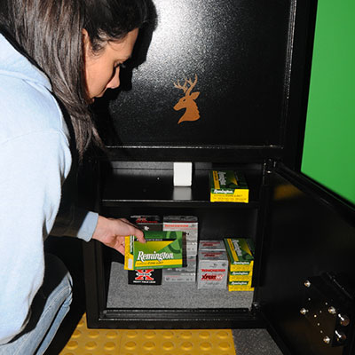
Store firearms and ammunition separately
What is to the left or right of your target?
What is behind your target?
What is between you and your target?
If you are in possession of firearms, and they are not being carried or used you must store them in a purpose-built steel receptacle. The receptacle must be bolted to the structure of the premises if it weighs less than 150kgs.
Ammunition must be stored in a locked container, separate from any firearms.
Firearms must be fully unloaded when being stored.

Slide 28




Safety rule 7:
Avoid alcohol when handling firearms

Slide 29


Avoid alcohol and drugs when handling firearms
What is to the left or right of your target?
What is behind your target?
What is between you and your target?
Refuse to shoot with people who have been drinking or have been taking drugs.
It is illegal to carry or use a firearm under the influence of alcohol or drugs.
Good judgement is the key to safe handling and use of firearms.
Alcohol and drugs (including prescription drugs) can affect how you respond to situations, putting you and those around you at risk.
If in doubt check with your prescribing doctor.

Slide 30
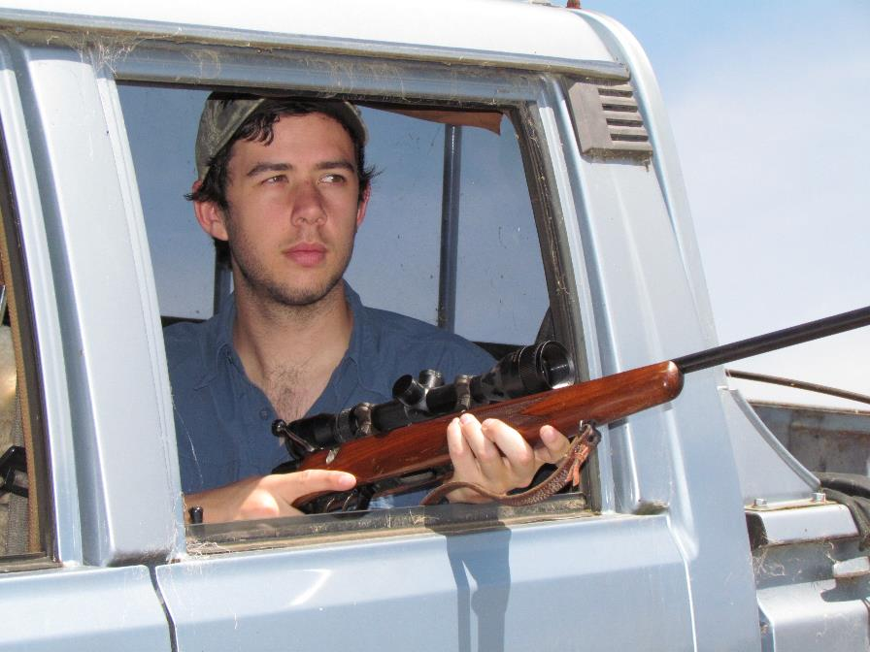
Safety rule 8:
Never have loaded firearms in the home, car or camp

Slide 31

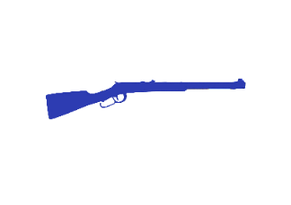
Never have loaded firearms in the home, car or camp
Only load when in your shooting area.
Before entering the home, a car or camp:
Point the muzzle in a safe direction and back drop and unload
Ensure that there are no rounds in the chamber or magazine.
Remove any detachable/external magazine.
Where possible, remove bolts, open the action, or use trigger locks.
Immediately return firearms to storage when not in use.

Slide 32
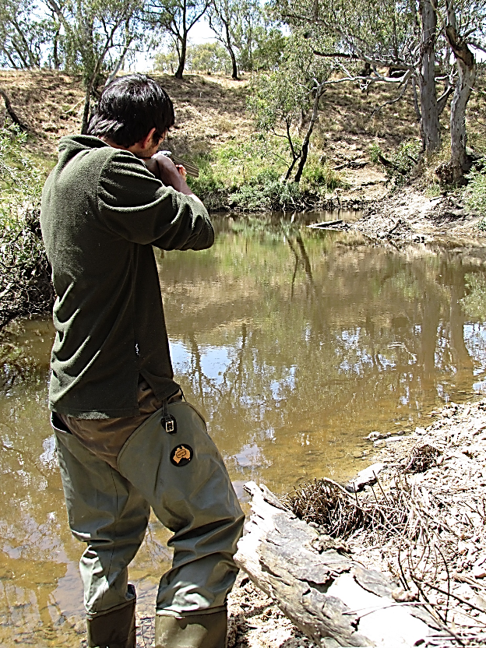
Safety rule 9:
Never fire at hard surfaces or water

Slide 33
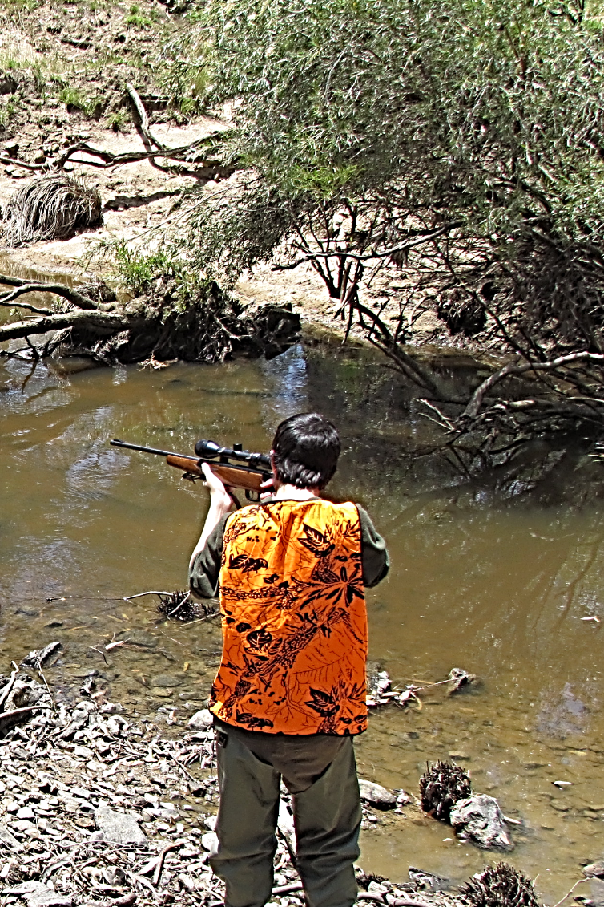
Never fire at hard surfaces or water
If you shoot at hard, smooth, flat surfaces or water and rocks, a ricochet will almost certainly result.
Ricochets can endanger lives.
If you're not sure that your shot will NOT cause a ricochet, DO NOT FIRE.
All rounds can ricochet.
What is to the left or right of your target?
What is behind your target?
What is between you and your target?

Slide 34
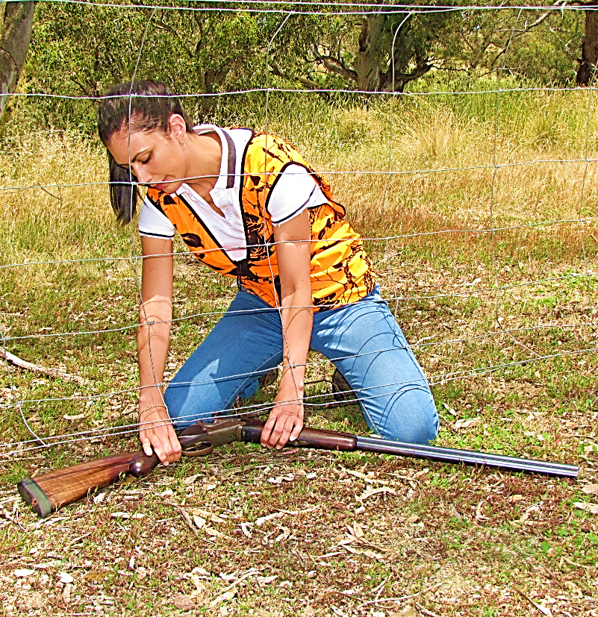
Safety rule 10:
Don’t climb fences or obstacles with loaded firearms

Slide 35
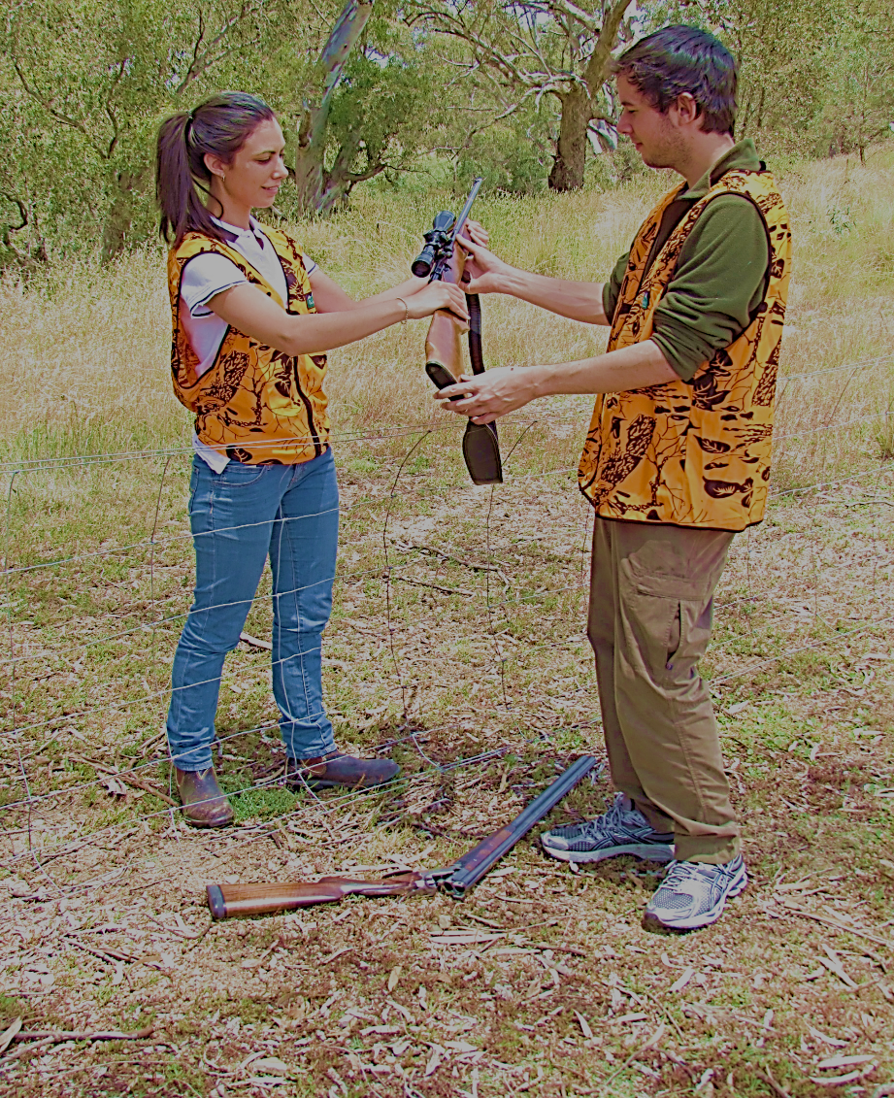
Do not climb fences or other obstacles with loaded firearms
What is to the left or right of your target?
What is behind your target?
What is between you and your target?
An ‘obstacle’ is any situation that may cause you to lose control of the muzzle direction.
Make sure that your firearm is unloaded before attempting to climb through a fence or negotiate any obstacle.
Don’t rely on the safety catch, they are only a supplement to safe handling.

Slide 36
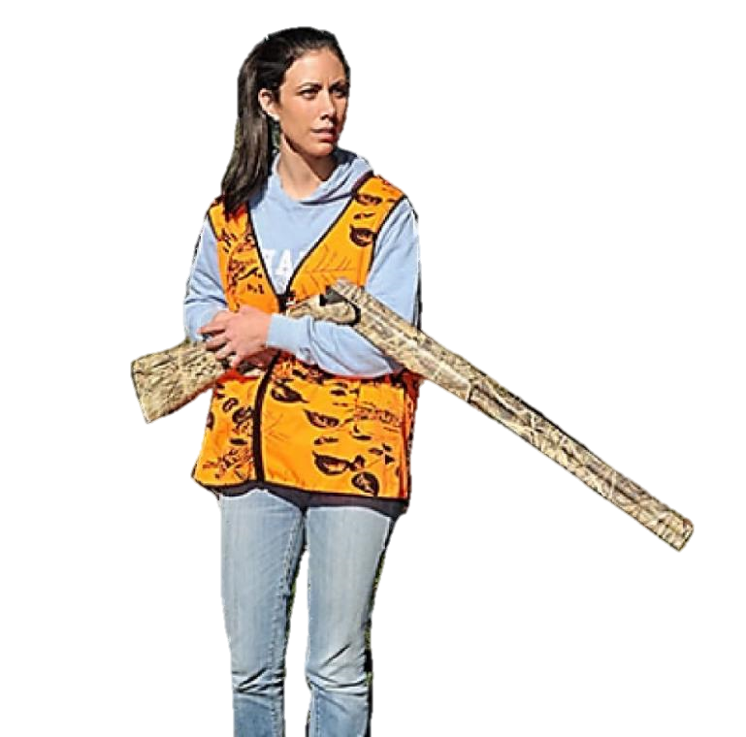
Handling firearms in the field

Slide 37






Personal safety
What is to the left or right of your target?
What is behind your target?
What is between you and your target?
Deer hunters travelling in remote areas should consider purchasing/hiring an EPIRB (Emergency Position Indicating Radio Beacon)
Tell somebody where you are going and when you expect to return.
Carry personal safety equipment in your day pack in-case of an emergency. Things like:
Mobile phone and charged power bank
First Aid Kit
Knife
Lighter
Compass
GPS
Wet weather gear
Blaze orange safety vest and/or cap
Torch or headlamp
Spare batteries
Water
Food

Slide 38
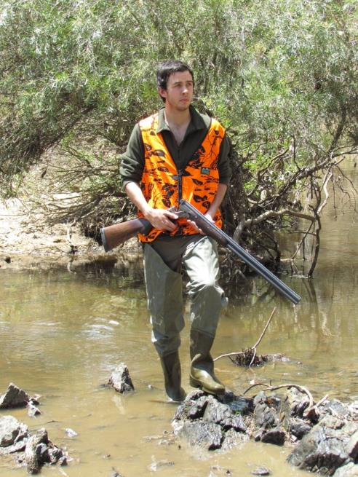
Hazard safety
What is to the left or right of your target?
What is behind your target?
What is between you and your target?
Remember! Safety catches are only supplementary to safe handling
Check the terrain and environment to identify hazards.
Look out for slippery rocks, submerged logs or rocks around ditches and streams.
If there is an increased risk of stumbling or falling, unload.
If you fall, unload your firearm before checking or clearing any barrel obstruction.
Use safety catches.

Slide 39
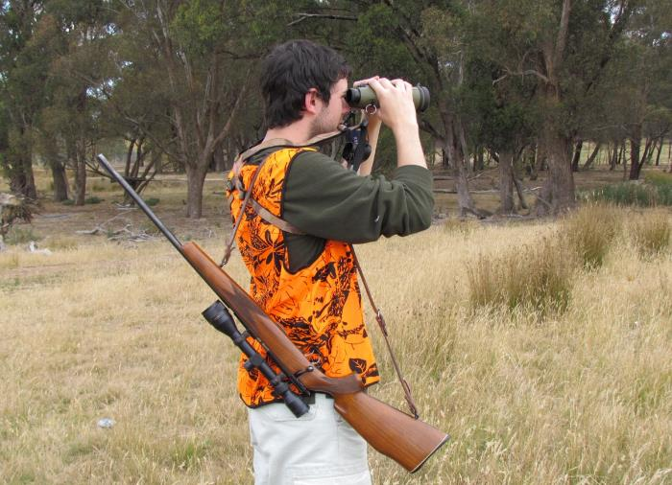
Hazard safety
What is to the left or right of your target?
What is behind your target?
What is between you and your target?
Testing safety catches – point in a safe direction and with a backdrop
Zeroing sights: Identify safe direction and back drop
Identifying your target: Using binoculars is a safer and more accurate way of identifying your target, than using your rifle scope

Slide 40
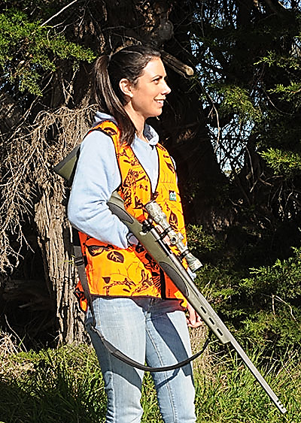
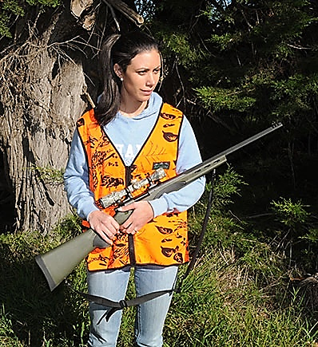
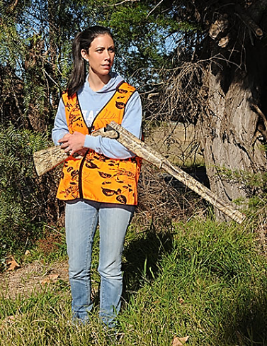
Hazard safety
What is to the left or right of your target?
What is behind your target?
What is between you and your target?
Where is my muzzle pointing?
Carrying firearms safely
Side cradle carry
Be aware where your muzzle is pointing, especially when with other shooters.

Slide 41
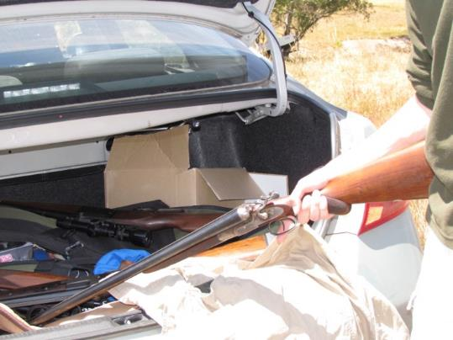
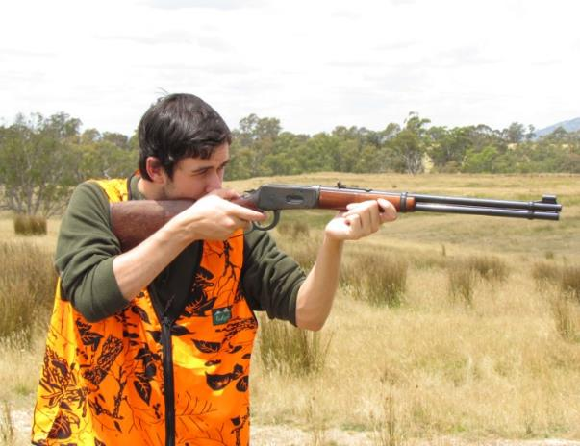
Hazard safety
What is to the left or right of your target?
What is behind your target?
What is between you and your target?
Exposed hammer firearms
Exposed hammers can create catch or snag points when removing firearms from a vehicle or moving in the bush.
This may cause the firearm to be cocked and ready for discharge unintentionally.
If this occurs, safety unload in a safe direction and return the hammer to the uncocked position.

Slide 42
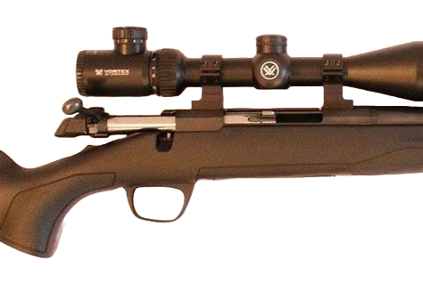
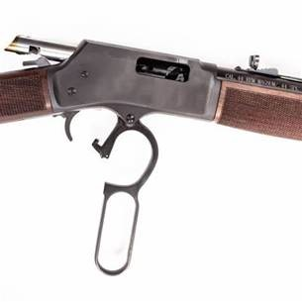
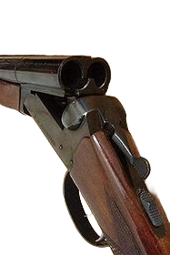
Firearm readiness
What is to the left or right of your target?
What is behind your target?
What is between you and your target?
Bolt action
Break open firearm
Bolt action firearm
Lever action firearm
Pump action firearm
Hammer firearms
Tubular magazines
Hammer
Break open

Slide 43
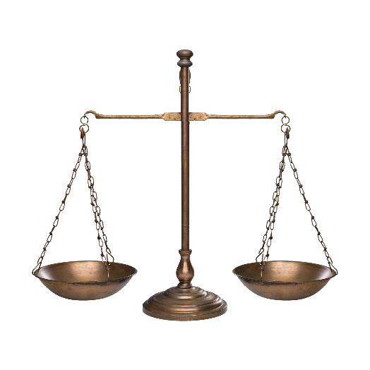
Victorian firearms laws

Slide 44

Victorian firearms laws
For news and information go to www.police.vic.gov.au/firearms
What is to the left or right of your target?
What is behind your target?
What is between you and your target?
Firearms Act 1996
Firearms Regulations 2018
Wildlife Act 1975
Wildlife Regulations 2013
Victoria is a signatory to the National Firearms Agreement.
Victoria Police publishes information about changes to firearms laws on police.vic.gov.au/firearms .

Slide 45

Victorian firearms laws
Licence categories
For news and information go to www.police.vic.gov.au/firearms
What is to the left or right of your target?
What is behind your target?
What is between you and your target?
Category A, B, C, D, E longarms
Junior (longarm and handgun)
Paintball marker
Category 1 and 2 collectors
General category handgun
Category E handgun
Antique handgun
Dealer
Junior Longarms
Category A&B Longarms

Slide 46


Victorian firearms laws
Category A
For news and information go to www.police.vic.gov.au/firearms
Carry, possess or use:
an airgun
a rimfire rifle (excluding semi-automatic rimfire rifle)
a shotgun (excluding lever action, pump action or semi-automatic shotgun)
any combination of a shotgun and rimfire rifle
Genuine reason:
Hunting
Sport or target shooting
Primary production

Slide 47

Victorian firearms laws
Category A & B
For news and information go to www.police.vic.gov.au/firearms
Carry, possess or use:
a muzzle loading firearm
a centre fire rifle (excluding automatic or a semi-automatic centre fire rifle)
any combination of a shotgun and centre fire rifle
a black powder, ball firing cannon
a lever action shotgun with a magazine capacity of no more than 5 rounds
Genuine reason:
Hunting
Sport or target shooting
Primary production

Slide 48
Victorian firearms laws
Junior licence
Junior licences may be issued to a child who is at least 12 years old and under 18.
The category of firearm that juniors may use is listed as a genuine reason on their licence.
• Supervised category A&B
• Supervised category C (must have club membership)
• Supervised handgun (must have club membership)
Genuine reason:
Receiving instruction in the use of such firearms
Engaging in sport or target shooting competitions
Junior licence holders must only carry or use firearms under the immediate supervision of an adult licence holder.

Slide 49
Victorian firearms laws
Applying for a licence
Information about licence applications and licence eligibility can be found at police.vic.gov.au/firearms.
Steps:
Complete your application online – follow all instructions.
Send your application to Licensing and Regulation Division (LRD).
You must be able to verify your identity – make sure you have all the correct documents.
You must be able to provide evidence of genuine need.
LRD publishes application timeframes on their website. Check the website before emailing or calling.
If there is information missing from your application, or LRD needs to make enquiries your application will be delayed.
If your application is approved you need to make payment and have a photo taken.
Information about licence conditions of your licence are included with the payment notice – read it and keep it.

Slide 50
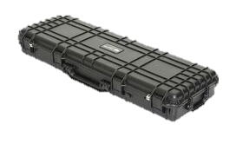
Carrying and managing firearms

Slide 51
Carrying firearms in public
It is dangerous and illegal to carry loaded firearms in any type of transport or in a public place.
When carrying or using a firearm or cartridge ammunition you must:
Ensure that the firearm/cartridge ammunition is carried or used in a manner that is secure and is not dangerous.
Take reasonable precautions to ensure that the firearm or cartridge ammunition is not lost or stolen
In most circumstances firearms can be carried safely by:
Storing firearms in a padded or hard case. Firearms and magazines must not be loaded.
Limiting the operability of the firearm and where possible, removing bolts, opening the action, or using trigger locks.
Storing cartridge ammunition separately from the firearm. We recommend that you store ammunition in a lockable container while in a vehicle. You should keep any keys to the container in your possession.
Keeping firearms secure and out of sight of the public.
A common sense approach to storing firearms is essential. When not in use, firearms must be immediately returned to storage.

Slide 52
Carrying firearms while travelling
1
2
3
4
When travelling, you must take reasonable precautions to ensure your firearms are not lost or stolen.
Store your firearms out of sight, in a lockable case.
Firearms and magazines must be unloaded.
Store ammunition is a locked container, separate from the firearm.
When removing a firearm from a vehicle – remove it butt first.

Slide 53





Camping, backpacking or hiking
Take precautions to ensure firearms or ammunition are not lost or stolen
Leave a licensed person in camp to look after firearms.
OR
Take the firearms with you.

Slide 54



Firearm loss, theft or destruction
You must notify police within 24 hours of becoming aware that a
firearm is lost, stolen or destroyed.
Contact local police
Call 131 444
Online police.vic.gov.au/police-assistance-line-and-online-reporting
131 444

Slide 55




Changing address
You must notify Licensing and Regulation Division (LRD) in writing, within 14 days if you change address.
@LRD
If you change your home or postal address or the storage address of any or all of your firearms, you MUST notify LRD in writing (in writing includes notifying by online form and email).
Complete a change of details form online at police.vic.gov.au/change-details

Slide 56


Purchasing or acquiring firearms
Permit to Acquire (PTA)
To purchase or acquire a firearm, you must apply for and be issued a PTA.
You can apply for a permit to acquire by completing an application.
Applications can be found:
On the Victoria Police website - police.vic.gov.au/acquiring-transferring-and-selling-firearms
At firearm dealers – some dealers can complete applications online on your behalf.
At police stations.
There is a mandatory 28 day waiting period for the issue of your first PTA.
Once a PTA is received, you must pay the fee. You have 28 days from the date the PTA is issued to use it.
PERMIT
TO ACQUIRE

Slide 57

Firearm registration
All firearms must be registered. Any firearm that you own, possess or carry must be registered.
Any transfer of firearm ownership and registration must be facilitated by a licensed firearm dealer. The person taking ownership of a firearm must have a valid permit to acquire.
Firearm owners should have a firearm registration certificate for each firearm, issued by Victoria Police. Questions about firearm registrations should be directed to LRD.
Unwanted or unregistered firearms can be surrendered to:
  licensed firearm dealers
  local police
More information police.vic.gov.au/disposal-firearms-and-ammunition
Category A Longarm
Registered to: Licence Holder

Slide 58
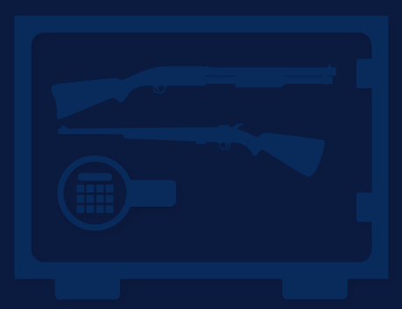
Firearm storage

Slide 59
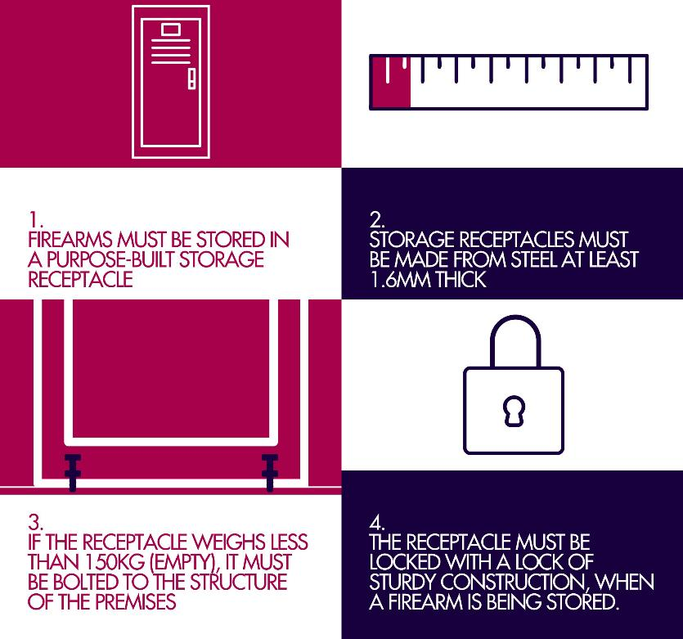
Category A & B longarm storage
Firearms and ammunition must be stored separately
It is a condition of a firearms licence that the holder of the licence must permit a police officer to inspect the holder’s storage arrangements at any reasonable time.

Slide 60
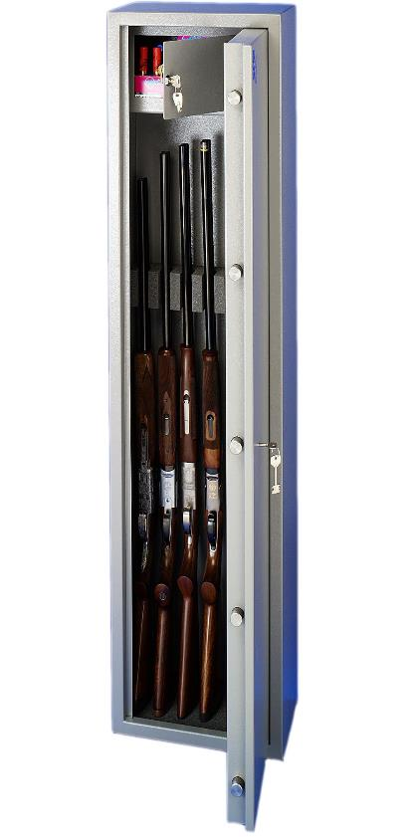
Ammunition storage
Ammunition must be stored in a locked container.
The ammunition container must be separate from the receptacle in which the firearm is stored.
Built-in lockable ammunition containers which have a separate key to access are acceptable.

Slide 61

Carriage of ammunition
When carrying ammunition, you must make sure that it is secure and safe.
You must also take care to ensure ammunition is not lost or stolen.

Slide 62

Before you go shooting

Slide 63



Private property
A firearm licence does not entitle you to shoot on private property.
You must have permission from the owner to shoot on private property – written or verbal.

Slide 64

Always keep your licence with you
A member of the police force, or an Authorised Officer under section 83 of the Conservation Forest and Lands Act 1987 can demand that you produce your firearm licence when you are in possession of a firearm.
It is an offence to fail to produce your firearm licence when requested.
Category A&B Longarms

Slide 65



Firearm preparation
Ensure your firearm is unloaded at all times when handling.
Muzzle in safe direction and appropriate backstop.
Ensure you have correct ammunition for your firearm. (Damascus twist barrel shotguns/old shotguns)
Check condition of your ammunition.
Check for rattling, noises or damage.
Ensure no barrel obstruction.
Check hammer function.
Ensure excessive oil is removed.

Slide 66

Possessing firearms and ammunition
What are you allowed to possess, carry or use?
You can only possess, carry or use the category of firearm specified on your licence.
You may only possess ammunition for the category of licence that you hold.
No one may not carry or possess firearms unless they are the holder of a licence.

Slide 67


Drugs and alcohol
Can you carry or use firearms when you are under the influence of alcohol or drugs?
It is an offence to carry or use a firearm while you are affected by drugs or alcohol.
This includes legal and prescription drugs.
Check your medications for warnings about driving or operating machinery after use.

Slide 68


Hunting game
You must hold a Game Licence if you wish to hunt:
Duck
Quail
Deer
Check the Game Management Authority website gma.vic.gov.au/hunting for information.

Slide 69

Mental health support
If you are struggling, there are 24/7 mental health support services available to help you.
Beyond Blue
Mental Health Support line
Target Group: Adults and young people
Phone: 1300 22 4636 (24 Hrs)
Lifeline
Mental Health Support line
Target Group: Adults and young people
Phone: 13 11 14 (24 Hrs)
Suicide Call Back Service
Mental Health Support and Referral line.
Target Group: Adults and young people
Phone: 1300 659 467 (24 Hrs)
vic.gov.au/current-mental-health-resources-support-services

